Slide 1
ECP4.1.9 Project Work (Foundation) on ML-assisted Signal Quality Assessment Of PPG Signals With Related Hardware Implementation
Presented By:
Archana Kumari
Univ. Roll no.– T91/ECE/204058
Univ Registration no.– D01-1211-0077-20
Shwashwat Das
Univ Roll no.– T91/ECE/204074
Univ Registration no.– D01-1111-0206-20
Btech in Electronics and Communication Engineering
Supervisor:
Dr. SUMITRA MUKHOPADHYAY
(Department of Radio Physics and Electronics, University of Calcutta)

Slide 2
Agenda
What is Signal Quality Assessment?
Literature Review
Computational tools used
Proposed Workflow
Work to be done in the Next Phase
References

Slide 3
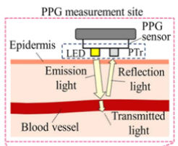
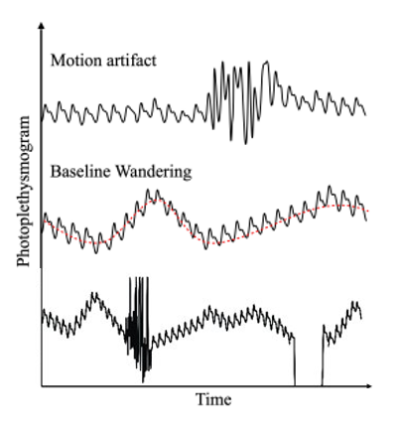
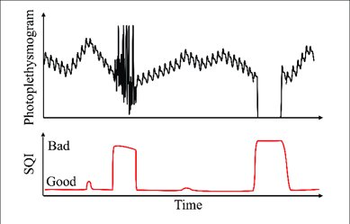
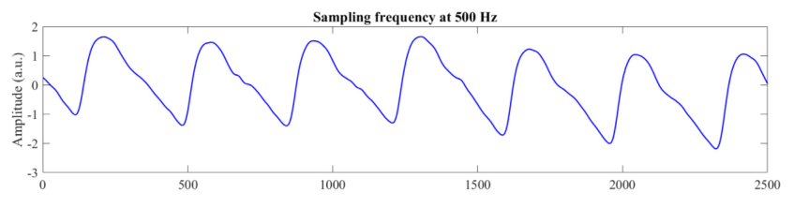
PPG based wearable devices
1.56 billion
hypertensive
patients by 2030
Focus shifts from treatment to prevention
Motivation
Why PPG over ECG?
PPG acquisition is easy (single lead vs at least two leads for ECG)
PPG sensors are smaller, more acceptable for patients
ECG sensors restrict movement
Health Monitoring
What is Signal Quality Assessment (SQA)?
Fig 2: PPG signal
Aims to improve the reliability of artifact-prone signals
Reduces erroneous predictions
Corruptions in PPG
PPG signal – easy to acquire but prone to many corruptions
Saturation
NZA
Fig 3: Example of SQI for PPG signal
Fig 4: Normal PPG segment
Fig 5: Various corruptions in PPG signal

Slide 4
Literature Review
Table 1: Some selected previous research work on the field of Signal Quality Assessment
Ref. No. | Venue(year) | Dataset used | Signal processing/ ML Tools used | Performance metrics
 | Biomedical Signal Processing and Control (2023) | MIMIC III | Attractor Reconstruction Analysis | Accuracy (max): 98.17% F1-score (max): 97.00%
2. | Smart Health 28 (2023) | Collected from smartwatch 46 individuals Sampling frequency = 20Hz | Feature extracted: 45 Feature selection: RFE Classification: One class SVM model | Accuracy = 0.97 FPR = 0.01
3. | IEEE Transactions on Biomedical Engineering (2022) | Pulsewatch Dataset: 30s length UMMC Simband Dataset: 37 patients Stanford PPG Dataset: 132 participants MIMIC III Dataset | Filtering: HPF(0.5HZ), LPF(20Hz) Peak detection: WEPD algorithm Feature selection: IWSSr algorithm Model: Ensemble feature selection technique | Accuracy: 94.09%, Sensitivity: 91.31% Specificity: 97.50%
4. | Computers in Biology and Medicine (2022) | MIMIC III PPG waveform database 1.6 million 5-s segment length PPG About 29 GB | ML model: DNN based 6CNN layers, 5s segment Sampling rate = 125Hz | Accuracy: 97.80% AUC: 0.980
5. | Biosens. Bioelectron (2022) | Physionet 3 healthy volunteers Sampling frequency = 125 Hz (for both) | Dynamic sensor configuration: MA removal Features used (SQA): Skewness, Kurtosis CNN-LSTM model for HR estimation | Accuracy: 95% Error in HR estimation: ±1.8 bpm R² = 0.99 (HR estimation)
Notes:
MAQR: Missed acceptable quality rate
MUAQR: Missed unacceptable quality rate

Slide 5
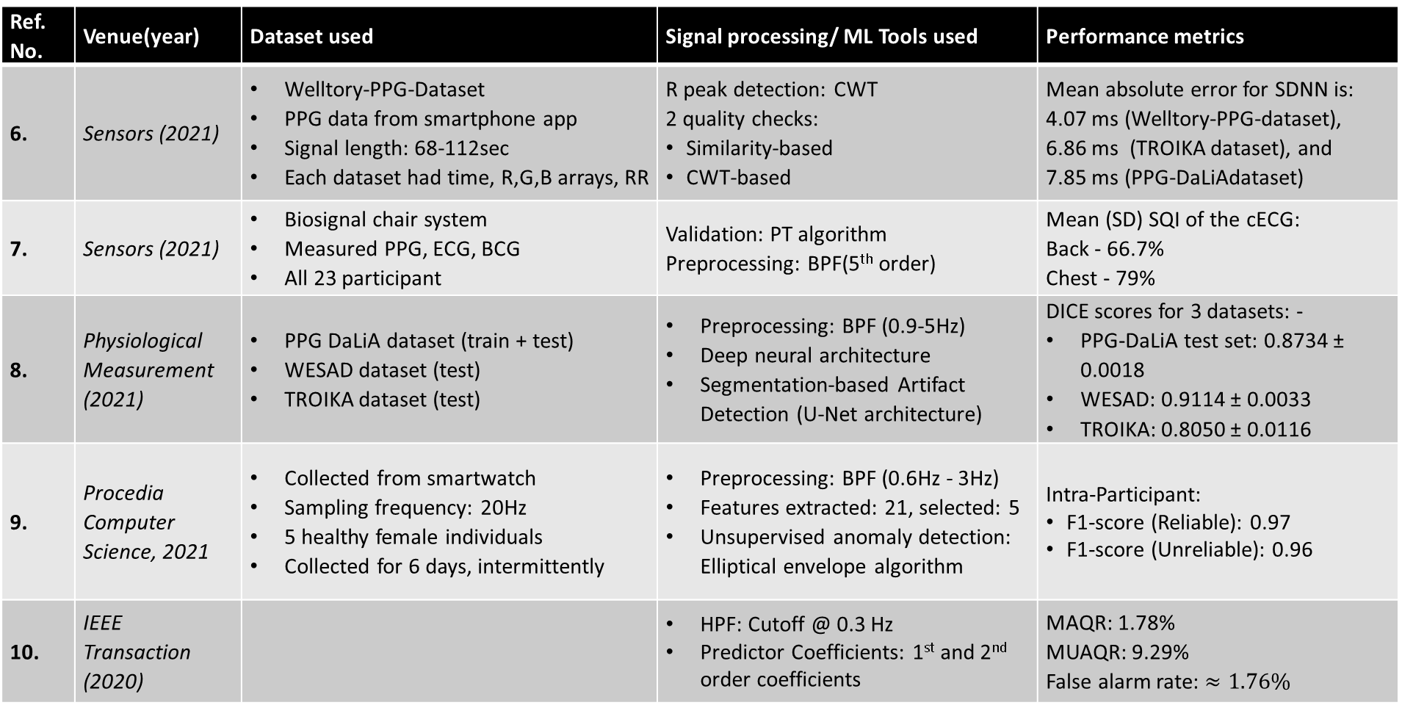
Continued…
Ref. No. | Venue(year) | Dataset used | Signal processing/ ML Tools used | Performance metrics
6. | Sensors (2021) | Welltory-PPG-Dataset PPG data from smartphone app Signal length: 68-112sec Each dataset had time, R,G,B arrays, RR | R peak detection: CWT 2 quality checks: Similarity-based CWT-based | Mean absolute error for SDNN is: 4.07 ms (Welltory-PPG-dataset), 6.86 ms (TROIKA dataset), and 7.85 ms (PPG-DaLiAdataset)
7. | Sensors (2021) | Biosignal chair system Measured PPG, ECG, BCG All 23 participant | Validation: PT algorithm Preprocessing: BPF(5th order) | Mean (SD) SQI of the cECG: Back - 66.7% Chest - 79%
8. | Physiological Measurement (2021) | PPG DaLiA dataset (train + test) WESAD dataset (test) TROIKA dataset (test) | Preprocessing: BPF (0.9-5Hz) Deep neural architecture Segmentation-based Artifact Detection (U-Net architecture) | DICE scores for 3 datasets: - PPG-DaLiA test set: 0.8734 ± 0.0018 WESAD: 0.9114 ± 0.0033 TROIKA: 0.8050 ± 0.0116
9. | Procedia Computer Science, 2021 | Collected from smartwatch Sampling frequency: 20Hz 5 healthy female individuals Collected for 6 days, intermittently | Preprocessing: BPF (0.6Hz - 3Hz) Features extracted: 21, selected: 5 Unsupervised anomaly detection: Elliptical envelope algorithm | Intra-Participant: F1-score (Reliable): 0.97 F1-score (Unreliable): 0.96
10. | IEEE Transaction (2020) |  | HPF: Cutoff @ 0.3 Hz Predictor Coefficients: 1st and 2nd order coefficients | MAQR: 1.78% MUAQR: 9.29% False alarm rate: $≈1.76\%$
MIT-BIH SLP
MIMIC-II
CSL
Wrist
Cup
IITBBS

Slide 6
Computational Tools
S. No. | ML Model | Description | Advantage(s) | Disadvantage(s)
1. | Logistics Regression | Uses logistic hypothesis function and Max Likelihood estimation to model probabilities | Simple and interpretable For linear relationships | Assumes linear boundaries, Sensitive to outliers
2. | Decision Trees | Tree-based model Entropy, Info Gain, Gini impurity | Numerical and Categorial data Robust to outliers | Prone to overfitting Sensitive to data changes
3. | Random Forest | Ensemble learning method Multiple decision trees | Robust and accurate Handle missing values | Computation extensive
4. | Support Vector Machines (SVM) | Finds optimal hyperplane with maximum margin | Effective for high dimensional space, Robust | Memory-intensive Sensitive to kernel parameters
5. | k-Nearest Neighbors (k-NN) | Instance-based learning Classify based on neighbors | Simple, adapts well to changes in data | Computationally expensive, Sensitive to outliers and imbalanced datasets
6. | Naïve Bayes | Probabilistic model based on Bayes' theorem with independence assumption. | Simple, fast, and scalable Less training needed | Assumes feature independence

Slide 7
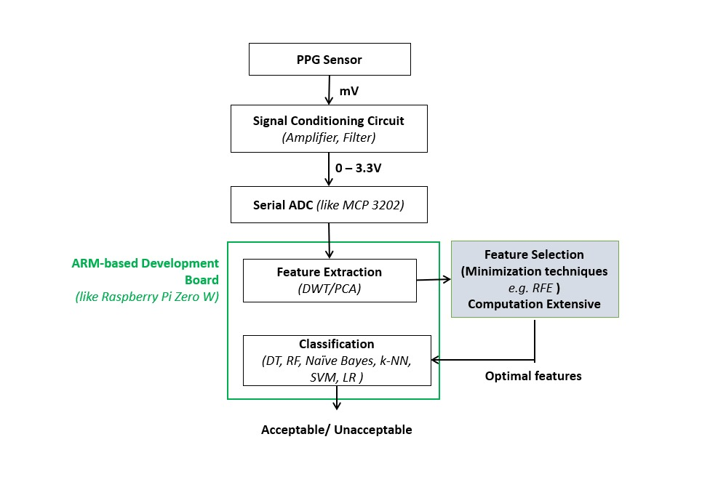
Proposed Workflow
Acquiring the signal
Sensor Placement
Light emission and detection
Signal conditioning
Signal preprocessing
Baseline correction (eliminate noise)
Feature Extraction
Feature Selection
3. Classification model
Training the classifier
Validation and Testing
Fig 7: Project Workflow/ Pipeline of PPG SQA method with hardware integration
Notes:
s

Slide 8
Current Status
Work to be done in the Next Phase
Next phase of work
Reviewed ten research papers in the domain of SQA
Read computational tools in Machine Learning:
Preprocessing tools: Data cleaning, Encoding, Normalisation(Min-Max Scaling), Standardisation(z-score)
Feature Extraction tools
ML classification technique: LR, DT, RF, SVM, k-NN, NB
Performance evaluation metrics: Accuracy, confusion matrix, Precision and Recall, F1-score, AUC-ROC curve, DICE score.
End-to-end implementation with hardware integration:
Data acquisition system using PPG sensor
Data preprocessing
Feature extraction and feature selection
Classification algorithm
Evaluating the performance metrics
Optimization of the algorithm
Hardware implementation

Slide 9
References
J. Schmith et al., “Photoplethysmography signal quality assessment using attractor reconstruction analysis,” Biomed. Signal Process. Control, vol. 86, 2023, doi: 10.1016/j.bspc.2023.105142.
M. Feli, I. Azimi, A. Anzanpour, A. M. Rahmani, and P. Liljeberg, “An energy-efficient semi-supervised approach for on-device photoplethysmogram signal quality assessment,” Smart Heal., vol. 28, 2023, doi: 10.1016/j.smhl.2023.100390.
F. Mohagheghian et al., “Optimized Signal Quality Assessment for Photoplethysmogram Signals Using Feature Selection,” IEEE Trans. Biomed. Eng., vol. 69, no. 9, pp. 2982–2993, 2022, doi: 10.1109/TBME.2022.3158582
H. Shin, “Deep convolutional neural network-based signal quality assessment for photoplethysmogram,” Comput. Biol. Med., vol. 145, 2022, doi: j.compbiomed.2022.105430.
B. Ngoc-Thang, T. M. Tien Nguyen, T. T. Truong, B. L. H. Nguyen, and T. T. Nguyen, “A dynamic reconfigurable wearable device to acquire high quality PPG signal and robust heart rate estimate based on deep learning algorithm for smart healthcare system,” Biosens. Bioelectron. X, vol. 12, 2022, doi: 10.1016/j.biosx.2022.100223.
A. Neshitov, K. Tyapochkin, E. Smorodnikova, and P. Pravdin, “Wavelet analysis and self-similarity of photoplethysmography signals for HRV estimation and quality assessment,” Sensors, vol. 21, no. 20, 2021, doi: 10.3390/s21206798.
S. Hong, J. Heo, and K. S. Park, “Signal quality index based on template cross-correlation in multimodal biosignal chair for smart healthcare,” Sensors, vol. 21, no. 22, 2021, doi: 10.3390/s21227564.
A. Mahmoudzadeh, I. Azimi, A. M. Rahmani, and P. Liljeberg, “Lightweight photoplethysmography quality assessment for real-time IoT-based health monitoring using unsupervised anomaly detection,” in Procedia Computer Science, 2021. doi: 10.1016/j.procs.2021.03.025.
Z. Guo, C. Ding, X. Hu, and C. Rudin, “A supervised machine learning semantic segmentation approach for detecting artifacts in plethysmography signals from wearables,” Physiol. Meas., vol. 42, no. 12, 2021, doi: 10.1088/1361-6579/ac3b3d.
G. Narendra Kumar Reddy, M. Sabarimalai Manikandan, and N. V. L. Narasimha Murty, “On-Device Integrated PPG Quality Assessment and Sensor Disconnection/Saturation Detection System for IoT Health Monitoring,” IEEE Trans. Instrum. Meas., vol. 69, no. 9, 2020, doi: 10.1109/TIM.2020.2971132.

Slide 10
Thank You ☺

Slide 11
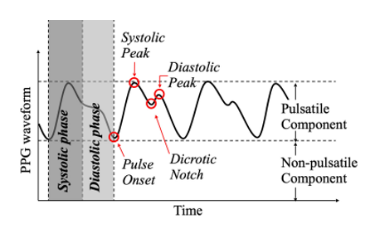
Photoplethysmography (PPG)
PPG is an optical technique to measure blood volume changes in small portion of tissue.
Components of PPG signal:
Pulsatile: Variable component, signifies heart activity.
Non-pulsatile: Signifies fixed attenuation due to tissue.
Some characteristic features of PPG signal:
Pulse onset: Marks start of heart beat.
Systolic/Anacrotic phase: Rising edge due contraction heart.
Diastolic/Catacrotic phase: Signifies relaxation of heart beat.
Systolic peak: Maximum of PPG value in systolic phase.
Diastolic peak: Minimum of PPG value in diastolic phase.
Diacrotic Notch: Dip in diastolic phase.
Fig 8: PPG Signal and characteristic points

Slide 12
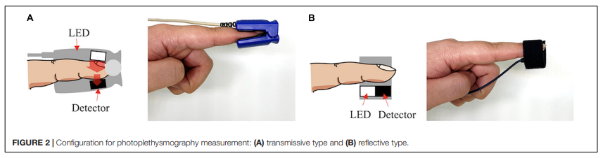
TYPES OF PPG SENSORS
Fig 9: Configuration for PPG measurement: (A) Transmissive type (B) Reflective type
Table 2: Difference between two types of sensors
 | Transmissive type | Reflective type
LED – Photodector placement | On different sides of the tissue | On same sides of the tissue
Measures changes in | Transmitted light intensity | Reflected light intensity
Applications | Fingertip pulse oximeters | Wearable devices like smartwatches
Challenges | Vulnerable to motion artifacts | Susceptible to ambient light interference

Slide 13
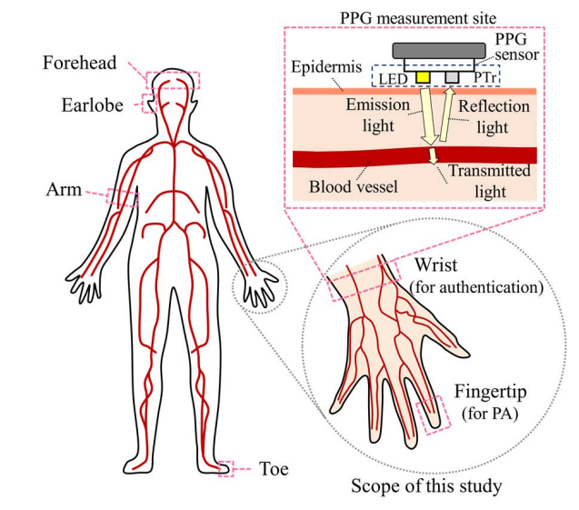
Different measurement sites for PPG
Acquire PPG signal from:
Fingertip/Toe: Most common site for pulse oximeters.
Earlobe: Used for continuous monitoring.
Forehead: Used when above two are not practical.
Wrist: Used by fitness bands and smartwatches.
Arm: More stable site, lets user more freedom.
Choice:
Physiological parameters being measured.
Availability of site, there can be other sensors on that site.
Some are more reliable than others.
User comfort.
Fig 10: Most common measurement sites for PPG.
Notes:
Earlobe -> ear ring can be used

